Slide 1



SIGNATURE
MAKER
A DYNAMIC POKÉMON EXPLORER WEB APP WITH ADVANCED SEARCH, FILTERING, COMPARISON, AND FAVORITES FEATURES USING REACT AND THE POKÉAPI.

Slide 2

CONTENT
INTRODUCTION & OBJECTIVES
TECH STACK
MODULES
GLIMPSES OF OUR WEBSITE
FUTURE SCOPES
CONCLUSION

Slide 3

OBJECTIVES
Introducing a Query Website:
In an increasingly digital world, the ability to sign documents online is essential. Signature Maker Avi provides a smooth, browser-based experience for creating and downloading handwritten digital signatures, eliminating the need for scanners or external apps.
Allow users to draw a digital signature freely
Provide options to preview, clear, and redo signatures
Enable image download of the signature as .png
Deliver a fast, responsive experience across devices
Keep the tool purely frontend with zero backend dependency

Slide 4


TECH STACKS
Frontend
Deployment
Other Features
HTML5 Canvas for drawing
Download as PNG
Responsive design
No backend used
React.js
HTML5 Canvas API
CSS3
JavaScript
Vercel

Slide 5
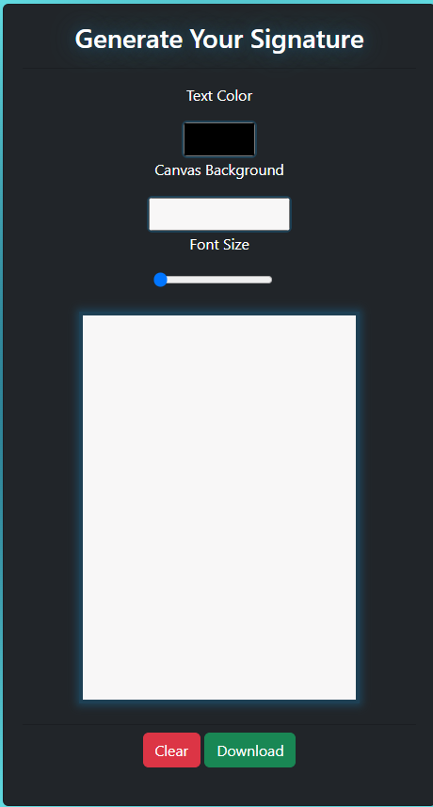

MODULES
Drawing panel
Action Controls
Users can draw using mouse or touch
Canvas element captures signature strokes
Clear – Erase the signature
Undo – Remove the last stroke (optional feature)
Download – Save signature as .png
Action Controls
Simple, minimalistic interface
Real-time preview of signature

Slide 6

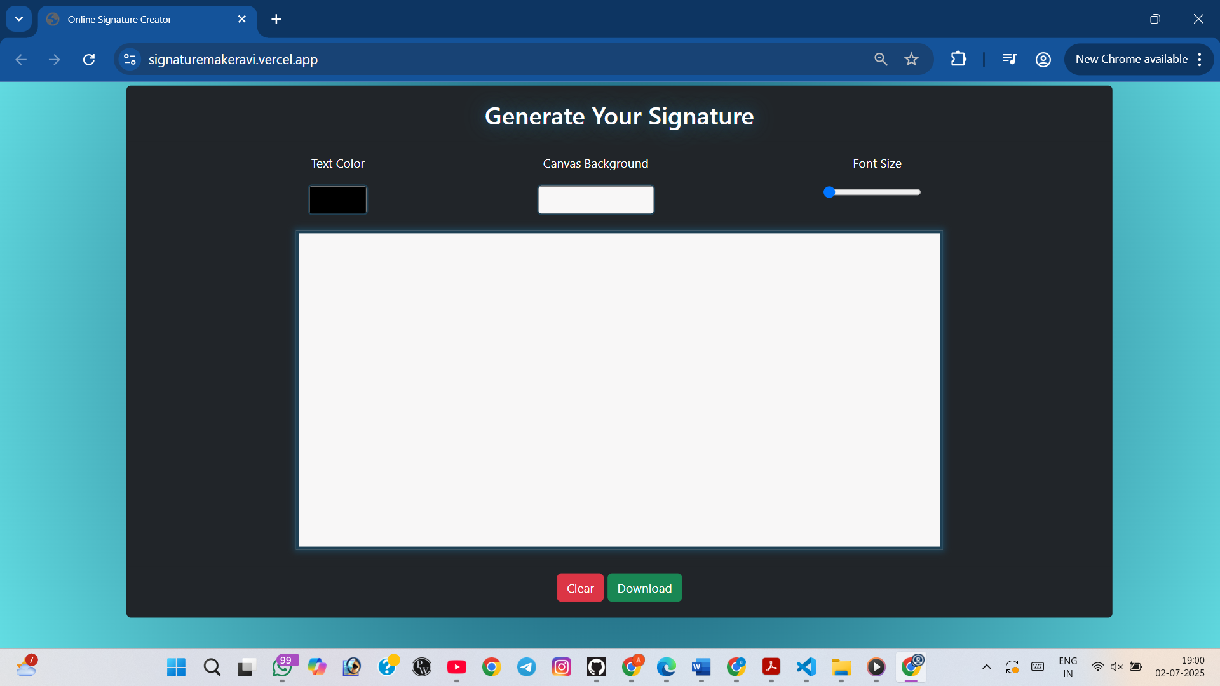

LANDING PAGE
NORMAL
MATERIAL
UI DESIGNS
USING
HTML CSS

Slide 7

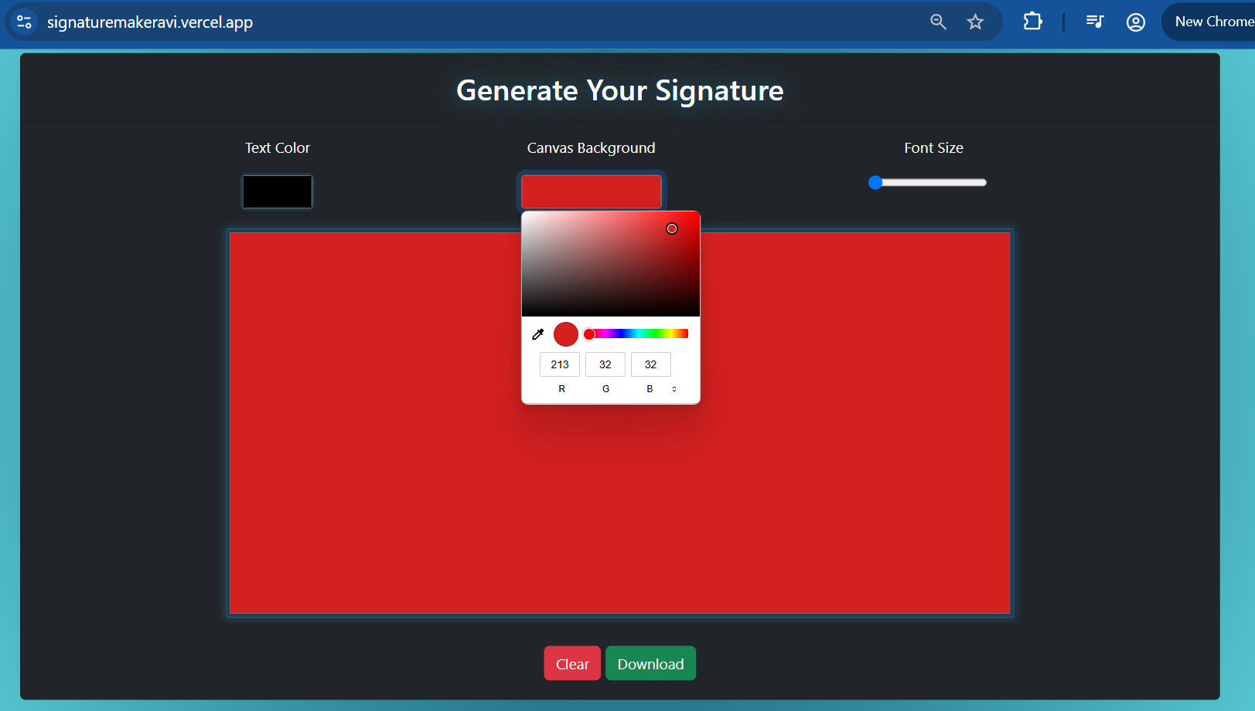
BACKGROUND COLOUR
CHANGE

Slide 8
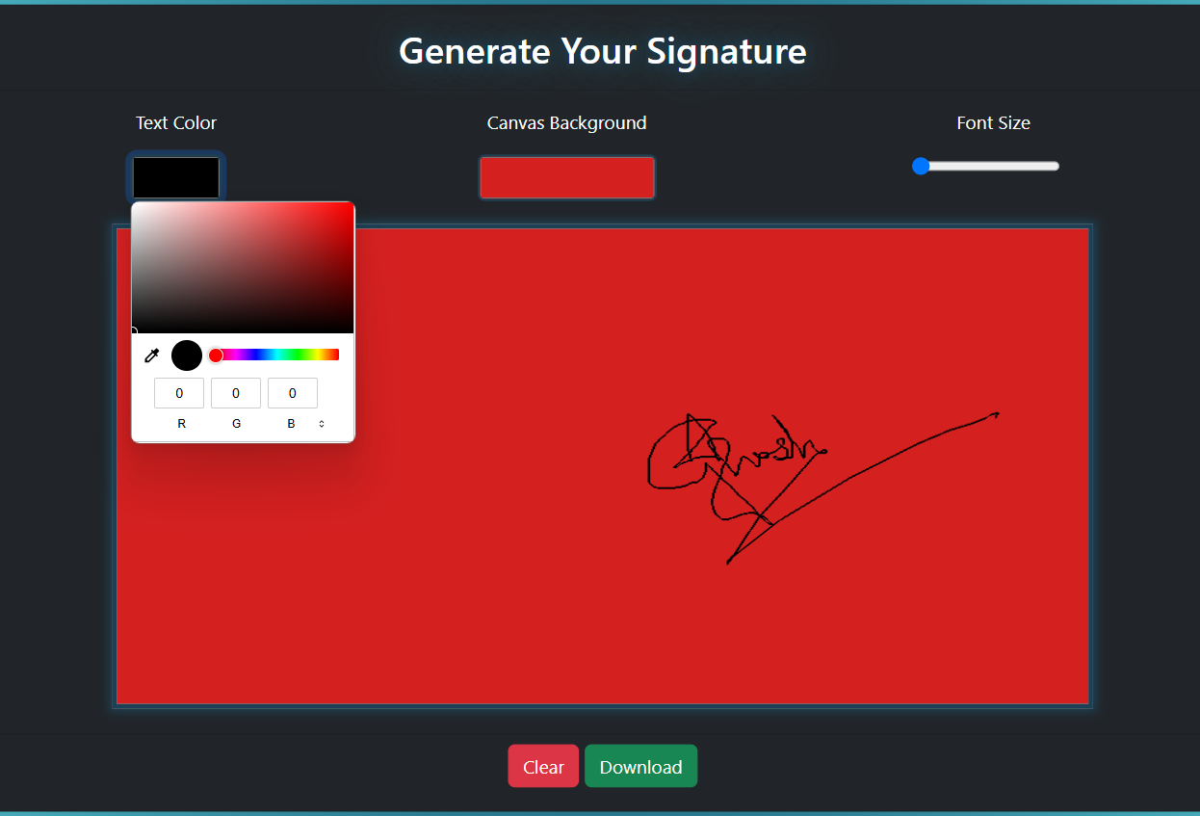
TEXT COLOUR
CHANGE

Slide 9
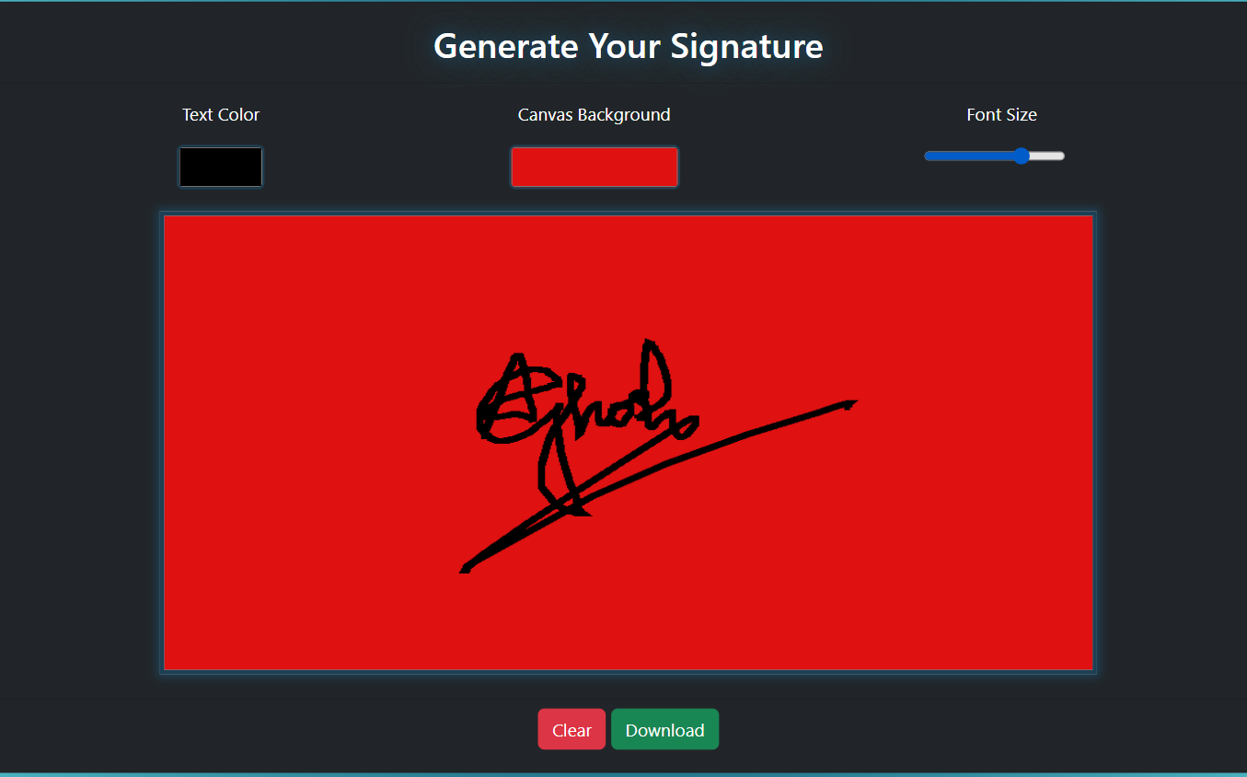
FONT SIZE CHANGE

Slide 10
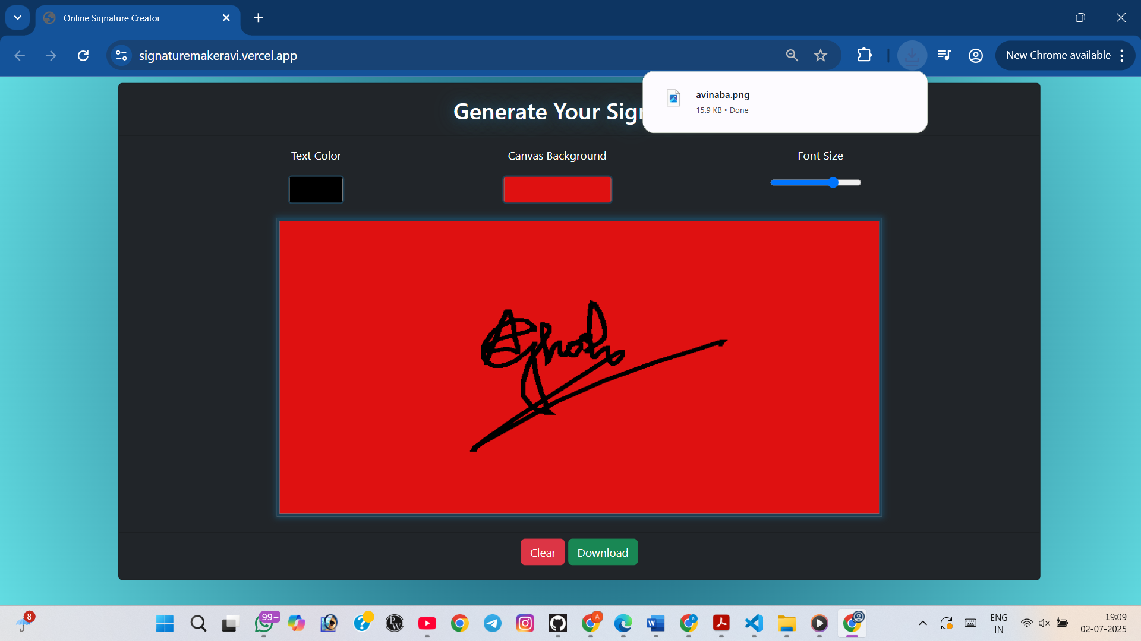

DOWNLOAD BUTTON
01

Slide 11
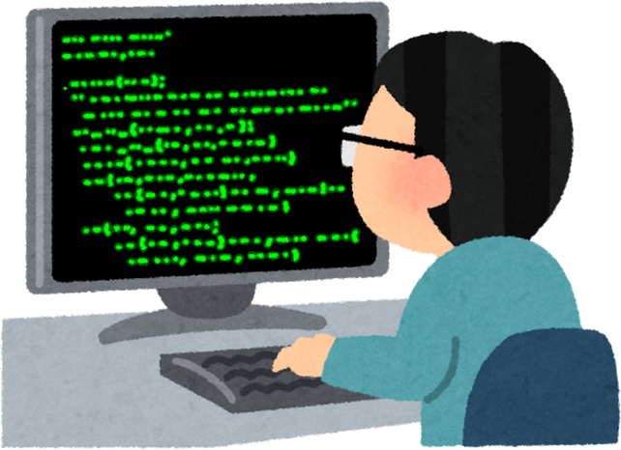


FUTURE SCOPES
Add support for multiple pen colors and thickness
Option to type a signature using custom fonts
Enable cloud save for registered users (if backend added)
Add drag-and-drop to insert signature into uploaded PDFs
Integrate with Google Drive or Dropbox for document signing

Slide 12



CONCLUSION
The Signature Maker Avi project demonstrates a practical application of frontend technologies to solve a real-world need: creating digital signatures. Through this project, we gained experience in working with HTML5 Canvas, React hooks, and building responsive UI components, while also understanding the importance of user-centric design.

Slide 13

THANK
YOU
Submitted by:-
Avinaba Ghosh

